Slide 1

Judge advisor training
FIRST® LEGO ® LEAGUE Challenge
UNEARTHEDSM Season
2025-2026

Slide 2
In this series…
Welcome and thankyou!
The 2025-2026 UNEARTHEDSM theme and NEW IN 2025
An overview of the Judge Advisor role
Understanding the documentation
Preparing for the event
What to do on the day
The coaches’ meeting
The scheduled judging interviews
Award deliberations
The Dashboard and the Official Judging Spreadsheet
The closing ceremony script
Contact details and next steps

Slide 3


Slide 4
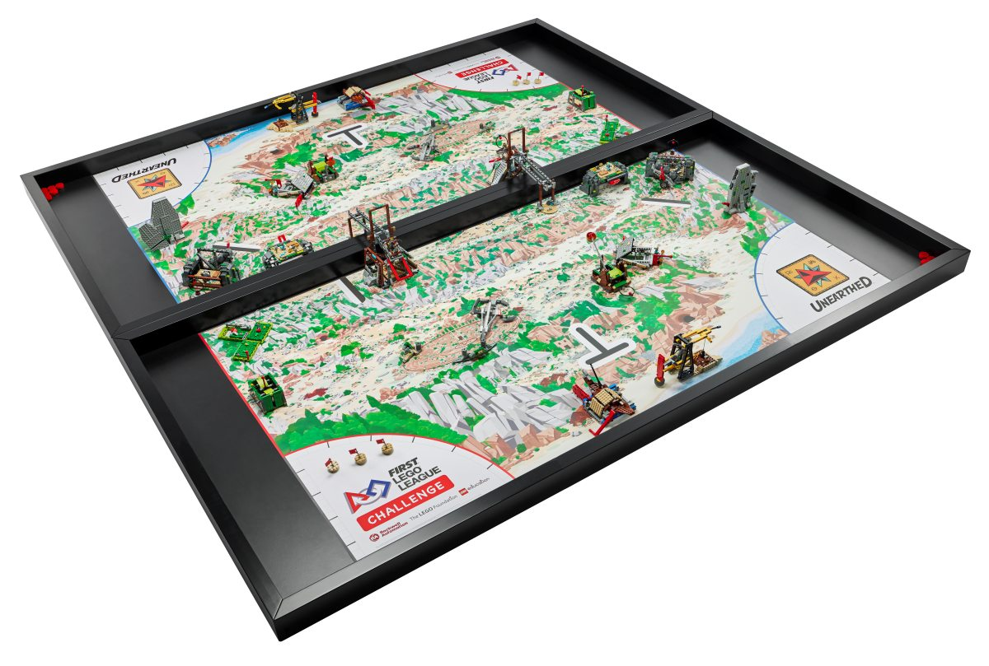
This year’s Theme: UNEARTHEDSM
During this archaeology-inspired season, teams use STEM and collaboration skills to unearth new findings about themselves and their collective communities to help build a better world.
Archaeologists use the archaeological process to reconstruct and understand the artifacts they have unearthed. Whether they are excavating a site or studying materials in a laboratory, it takes people working together with technology to find the clues needed to understand how past generations lived, learned, and celebrated.
In the UNEARTHED™ season, each team’s challenge is to identify a problem faced by archaeologists and propose a solution that can help.

Slide 5
Project Sparks
The Engineering Notebook contains “project sparks” – scenarios and questions to get teams thinking about possible project ideas. These include:
How archaeologists identify possible locations for artifacts
How technology can be used to map archaeologic sites
What tools archaeologists use to excavate fragile artifacts
How restoration processes can be improved
How archaeologists can work with professionals in other careers
The Engineering Notebook also includes a “careers and technology” page. The list includes archaeologists, site managers, lab technicians, conservators, anthropologists and geologists. This page can also inspire engaging and innovative project ideas!

Slide 6
What’s new this year?
Last season saw major changes to judging, including the new Peer Award, the introduction of the Final Share & Feedback interview component, and updates to rubrics.
There are no major changes to awards or processes for this season. However, some new resources are available.
On firstaustralia.org:
Updated Official Judging Spreadsheet (AUS version) available from firstaustralia.org
On firstinspires.org – US-specific, so use with caution!
Judge Guide and Quiz
Judge Advisor Checklist, Judge Training Script and Judge Training Slide Deck

Slide 7
Important reminders
Please be aware that different regions follow different procedures and use different document versions. As a Judge Advisor for an Australian event, it is important that you are using:
Up-to-date judging materials for the 2025-2026 UNEARTHEDSM season
Modified Judging Session Scripts, available from the FIRST Australia website
The Australian version of the Official Judging Spreadsheet, available from the FIRST Australia website
Ask your tournament director for access to the appropriate page on the FIRST Australia website.

Slide 8
Equity, Diversity and Inclusion
FIRST is committed to fostering, cultivating and preserving a culture of equity, diversity, and inclusion. We embrace and encourage differences in race, ethnicity, national origin, sex, gender, gender identity, gender expression, sexual orientation, disability, age, religion, income, language, learning difference, or any other characteristics that make our adult-force and students unique.
You can help by:
Checking with your Tournament Director about accessibility of judging rooms
Requesting that coaches to let you know in advance about students who may require special considerations
Sharing relevant EDI training materials with your judges
Reminding volunteers to keep the FIRST Core Values in mind at all times!

Slide 9


Slide 10

The Judge Advisor Role

Slide 11
What is the judge advisor’s role?
“Rather than judge teams, the judge advisor oversees the judging process and judging quality for the event. The judge advisor ensures that FIRST LEGO League Challenge Standards for Judging and Awards are followed and FIRST LEGO League event rubrics are used. Judge advisors are responsible for overseeing all judges for the event, including any necessary pre-event communication and training.
“Judge advisors assure paperwork is provided for the judges (including rubrics, session flowchart, judge questions, session script and awards list) for each pod. Being a Judge advisor requires familiarity with the advancement policy and training to use the Official Judging Spreadsheet.
“Judge advisors should always uphold and model the FIRST Core Values: Discovery, Inclusion, Innovation, Impact, Teamwork and Fun.”

Slide 12
What does the judge advisor do?
Before the event:
Liaise with the tournament director
Ensure judges receive training
On the day:
Attend the coaches’ meeting
Keep judging sessions on time
Run deliberations
Prepare the closing ceremony script (and PowerPoint)
After the event:
Submit awards and advancing teams to the Tournament Director

Slide 13
What are the key documents?
For the Judges:
For the Judge Advisor:
Judging Session Flowchart
Judging Session Script (AUS Version)
Rubrics
Awards
Team List
Judging Schedule
Awards and Allocation
Participation Rules
Coach/Mentor Award and Peer Award nomination forms
Full Team Schedule

Slide 14

Before the event

Slide 15
Planning for the event
The Tournament Director is responsible for recruiting volunteers and assigning judges via the FIRST Australia system. Before the event, you need to:
Request a volunteer list, including email addresses, so that you can make contact with your judges. Make sure they know where to find the judge training videos!
Check that there are enough judges for the event.
On the day, judges work in pods. Each pod has 3 judges and can interview at most 4 teams.
An event with 24 teams will require (24 ÷ 4) × 3 = 18 judges.
Confirm that all judges are 18+ and are not affiliated with a team competing at your event.
Allocate judges to a pod and role.
Each pod needs a robot design, innovation project and core values judge.
You should also assign one person to be the lead judge for each lane.
Aim for a good distribution of expertise and experience between pods.
Ask the Tournament Director about teams with students requiring special considerations.

Slide 16
Printing and supplies
At an in-person event, each pod should receive a clipboard with printouts of all the judging documents, and enough rubrics for four teams (plus spares). Judges will also need pens, highlighters and sticky notes – liaise with your Tournament Director to make sure these are available.
Some events are now paperless and will provide judges with tablets or laptops instead of printed documents. Ensure all devices have internet access and offline copies of key documents. Scrap paper and pens are still needed for these events!
Each pod must have its own room. There should be tables and chairs for the judges, and a clear open space for the team to do its presentation.

Slide 17
Nomination-based awards
To be eligible for the Coach/Mentor Award, teams must submit a hard-copy nomination form. It is best to collect these at the start of the day – ask your Tournament Director to arrange for these to be handed in during team check-in, or at the coaches’ meeting.
The Peer Award is based on nomination forms completed during the event. Talk to your Tournament Director about when and where these should be handed in.

Slide 18

On the day

Slide 19
Judge training?
Judges must watch the judge training video series prior to the event. On the morning of the event, ask the judges to attend a short meeting with you.
Introduce yourself and the judging pods
Remind the judges of their role in inspiring and encouraging the teams
Run through the event schedule: ceremonies, judging sessions, deliberations and lunch!
Let the judges know what AV (if any) is available in the judging rooms for teams
Let the judges know that all the documentation can be found in their pod’s folder (or on the provided device) and hand out the folders and stationery
Don’t forget to thank your judges and encourage them to keep volunteering!
While you attend the coaches’ meeting, suggest that the judges check out their judging rooms, and then attend the Opening Ceremony.

Slide 20
Coaches’ meeting
The Tournament Director will introduce you and invite you to speak during the coaches’ meeting. Use this opportunity to remind the coaches that:
Teams must be on time (or early!) – robot rounds can be rescheduled but judging cannot
Teams must be prepared with their Innovation Project props, robot and laptop (or code printouts)
All students must attend the judging session
The judging session is the team’s time to shine – coaches cannot contribute, prompt or otherwise interfere
Coaches can observe the judging session but the number may be limited (two allowed)
Judges are not to be photographed or filmed
Remind coaches to submit the Coach/Mentor Award nomination form!
Invite the coaches to let you know about any students that require special accommodations – and please let the relevant judges know ahead of the judging session.
Notes:
Teams are allowed two adults. Other children should NOT be permitted.

Slide 21
Scheduled interviews
While judging sessions are ongoing, the Judge Advisor’s role is to:
Monitor which teams have arrived for their session
At larger events, your Tournament Director may be able to provide you with a Judge Check-In volunteer
If a team is late, you can send the Judge Check-In volunteer to find them in the pits or at the Robot Game tables
Keep judges on schedule, and remind them to complete rubrics and feedback as they go!
Deal with questions and concerns as they arise
If you have the opportunity, consider using this time to collate and review the Coach/Mentor Award nomination forms.

Slide 22
Deliberations
The main role of the judge advisor is to guide the deliberations process and operate the Official Judging Spreadsheet (OJS).
All rubric data and (ideally) all robot game scores must be entered before deliberations commence.
Awards must be allocated in the correct order, described in the first tab of the OJS and in the Awards and Allocation document.
Not all events receive all the optional awards. Your Tournament Director should let you know what group of awards is available at your event.
Remember that teams can only receive one award, excluding the Coach/Mentor Award, Robot Performance Award, and Peer Award.
Teams care more about being recognised that what they are being recognised for.
However, it is important to get the Champion’s Award winner and advancing teams right!
What happens in the judging room, stays in the judging room.
Notes:
You can also have a judge assistant operate the spreadsheet.

Slide 23
Award eligibility
To be eligible for any award, teams must:
Have between 2 and 10 members
Be aged 9-16 years at the start of the year the challenge is released
Participate in all four aspects: Robot Game, Innovation Project, Robot Design and Core Values
Demonstrate the FIRST® Core Values and behave with Gracious Professionalism at all times
Award eligibility is outlined in the Participation Rules document.

Slide 24
How to determine an award
Sort the OJS according to the appropriate criteria then identify the top 2-4 teams.
Invite one judge from each relevant pod to speak about the team – limit speaking time to 1-2 minutes.
After everyone has spoken, check if any pods want to withdraw their team from consideration.
If there appears to be a clear winner, try to bring the judges to a consensus decision.
Otherwise, invite other judges to ask follow up questions. If no consensus can be reached, the award can be put to a vote.

Slide 25
Award allocation order
The award allocation order is described in the first tab of the OJS and on the last page of the Judge Advisor’s Awards and Allocation document.
Here is a summary:
Champion’s Award 1st Place, 2nd Place, 3rd Place…
1st Place Core Awards: Core Values THEN Innovation Project THEN Robot Design
2nd Place Core Awards: as above, then 3rd Place…
Optional Awards: Engineering Excellence THEN Breakthrough THEN Rising All-Star THEN Motivate
Coach/Mentor Award, Robot Performance Award and Peer Award are usually left until the end but can be done at any stage

Slide 26
Advancement
The number of advancing teams from your event is based on event size – ask your Tournament Director for the exact number.
Advancement eligibility is based on Champion’s Award criteria, meaning they must do well across the board.
Consequently, it is possible for a team to win the Robot Performance Award and the Robot Design award and not advance, if they did not do well on Innovation Project or Core Values criteria.

Slide 27
The coach/mentor and Peer awards
Coaches must be nominated by their team using the official nomination form to be eligible for the Coach/Mentor Award.
Don’t waste deliberations time going through every nomination form as a group! Instead:
Ask one pod to read all the forms and select the best three.
Have the pod summarise the three selected nominations during deliberations.
Reach a decision through consensus or vote.
Usually, one pod will finish earlier than the others. If not, the judge advisor can carry out this process.
The Peer Award is based on nominations made by teams during the event. You can use a similar process to decide this award.

Slide 28
The Dashboard and spreadsheet
The moment you’ve all been waiting for!

Slide 29
Award Scripts
After the awards are decided, the judges can write the award scripts. These should:
Describe why the team was chosen to receive the award
Give clues about the winner but only reveal their identity in the last lines
Be funny – use puns and jokes!
Follow an AABB rhyme scheme (use rhymezone.com)
Award scripts can be either:
4 lines for the Champion’s Award and 2 lines for the rest
8 lines for the Champion’s Award, 4 lines for 1st place required awards and 2 lines for the rest

Slide 30
Example Scripts
2nd Place Champion’s Award
Core Values Award
This team's tech log goes all season long
Shooting for the moon their GP is strong
Removing barriers for equal play they lead, don't follow
The judges are very pleased to congratulate Team Apollo
A truly inspirational team
That had a colourful hat theme
With the use of just three simple keys
They solved all of their problems with ease

Slide 31
Closing Ceremony Script
The closing ceremony script is auto-generated by the OJS. However, a few things must be entered manually:
The Coach/Mentor, Robot Performance Award and Peer Award winners
The name of the relevant National Championship for advancing teams
The event name, local sponsors and other details in the Opening and Closing Remarks
The award scripts
This (and preparing the PowerPoint) is a great job for a judge assistant if you have one!
If your event is using hard-copy rubrics, return these to the teams at the end of the Closing Ceremony. Please check the rubrics and feedback before returning them!

Slide 32
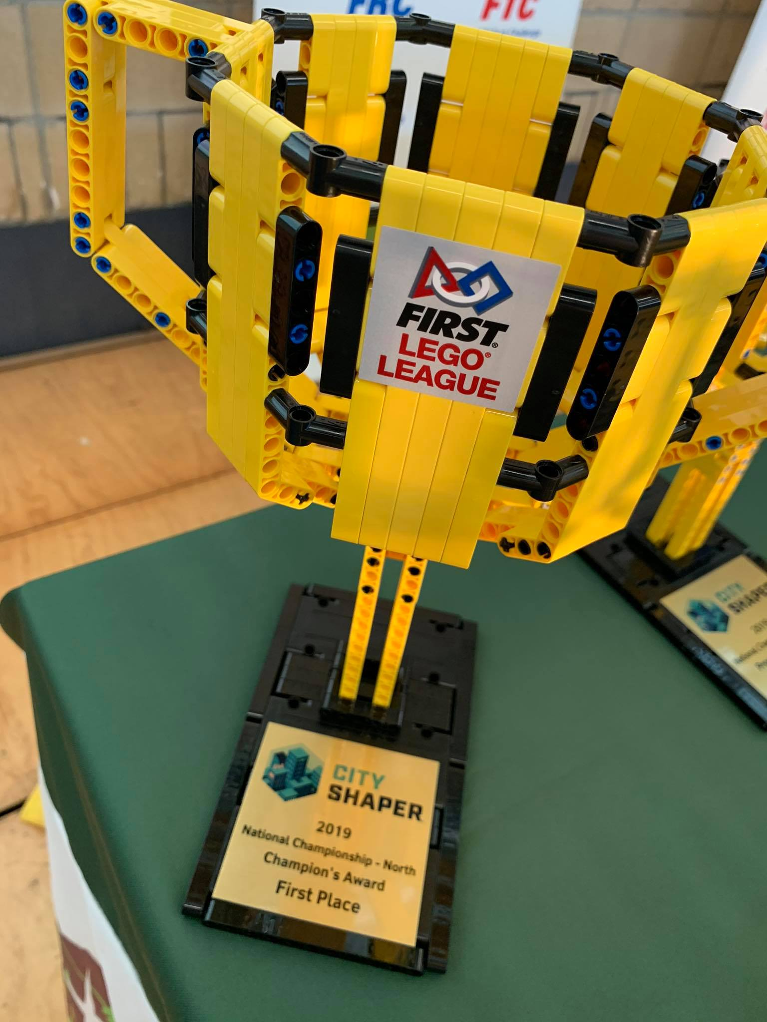
After the event
Following the event, please make sure the awards and advancing teams are provided to your Tournament Director to be communicated to FIRST Australia. We need this information to make contact with the advancing teams.
Completed rubrics should be returned to teams at the end of the Closing Ceremony. All other judging material should be disposed securely.

Slide 33
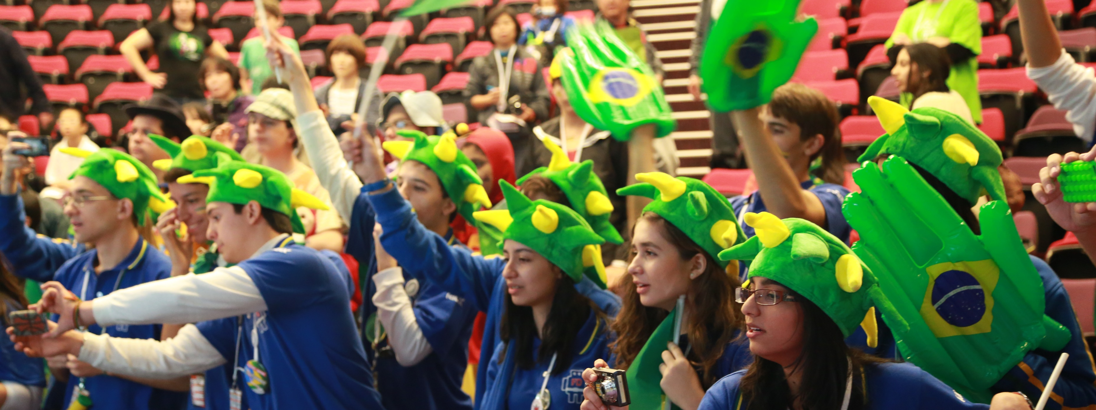
Reminders and Next Steps

Slide 34
Important Reminders
To ensure consistency and fairness across Australian and international events, as the judge advisor you MUST:
Attend the judge advisor training (check!)
Confirm judges are 18+ and not directly affiliated with teams competing at the event
Ensure all judges have been trained
Check that each pod has a separate, private room to conduct judging sessions
Use the current judging rubrics and related documents
Use the Australia version of the Official Judging Spreadsheet
Conduct a deliberations process involving all judges
Follow the awards structure your event has been allocated
Progress the correct number of teams to the relevant National Championship
Contact FIRST Australia if you are unsure of any procedures

Slide 35
10 tips for a successful event
Be prepared
Resolve any problems right away
You will need to manage situations that are not in the rule book
Remember you’re managing people, but…
Follow the rules
Focus on official and relevant judging criteria
Be aware of the time!
Create an atmosphere where everyone can contribute and have fun
See the teams!
Keep calm and robot on!

Slide 36
How to contact us
Judging questions: nationaljudgeadvisor_fll@ausfirst.org
Program questions: j.dwyer@mq.edu.au

Slide 37
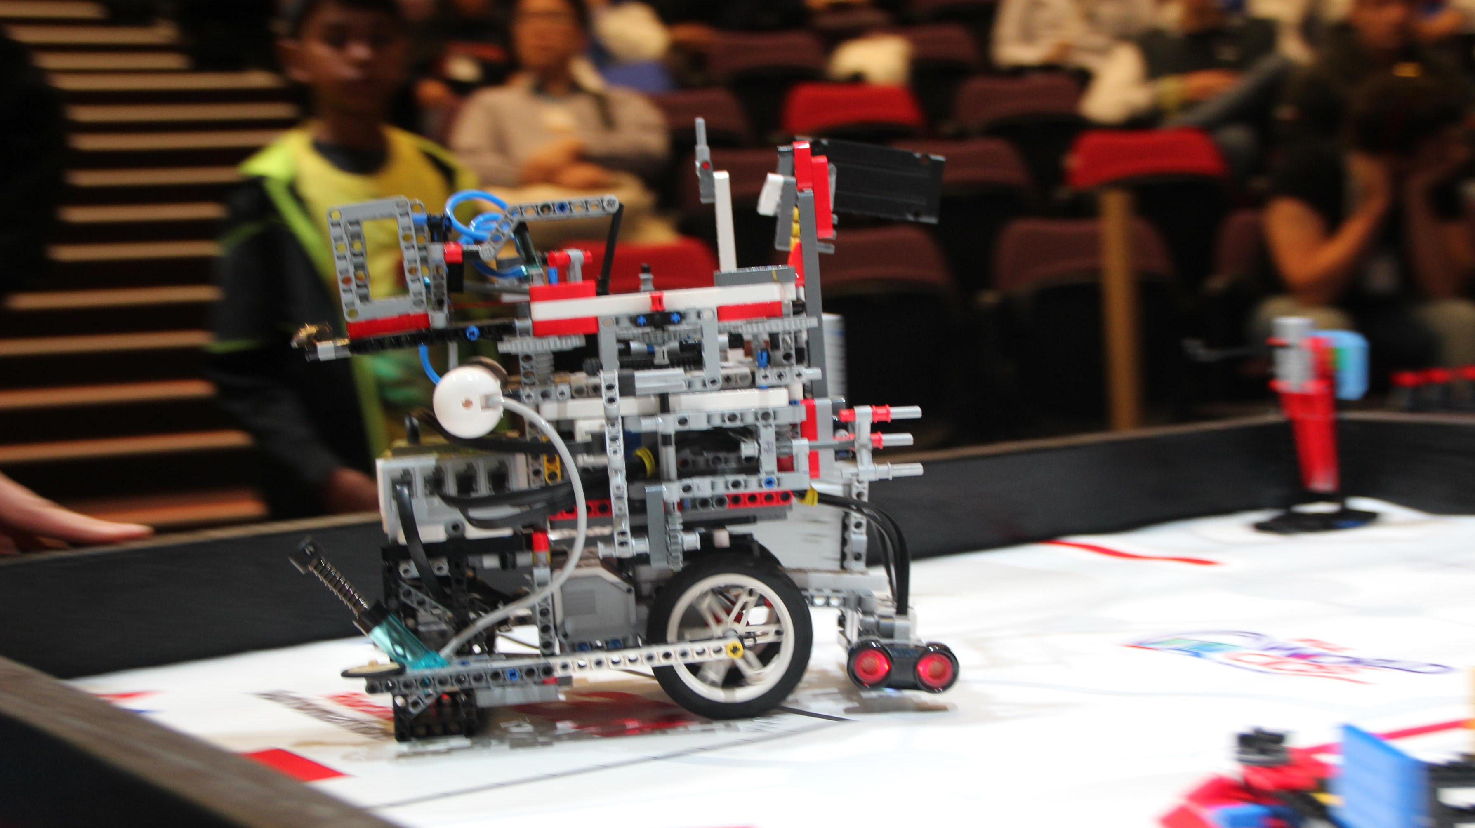
Questions?

