Slide 1
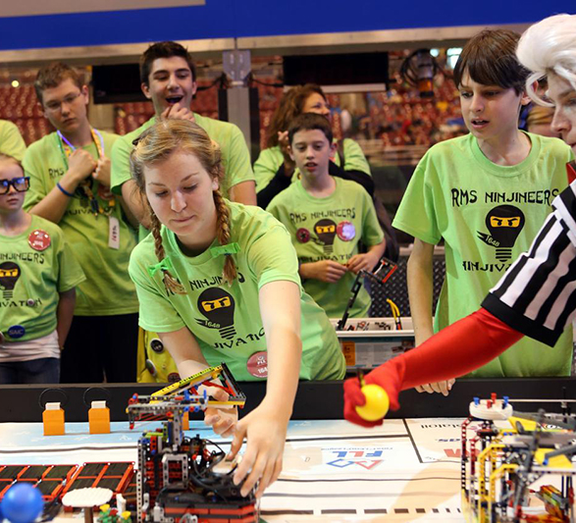
Judge training
FIRST® LEGO ® LEAGUE Challenge
UNEARTHEDSM Season
2025-2026

Slide 2


Slide 3
In this series…
Welcome and thankyou!
The 2025-2026 UNEARTHEDSM theme and NEW IN 2025
What is FIRST LEGO League Challenge?
Overview of the judging role
What does a judging interview look like?
Understanding the documentation
Providing feedback
What we are looking for
Award deliberations and scripts
Next steps

Slide 4
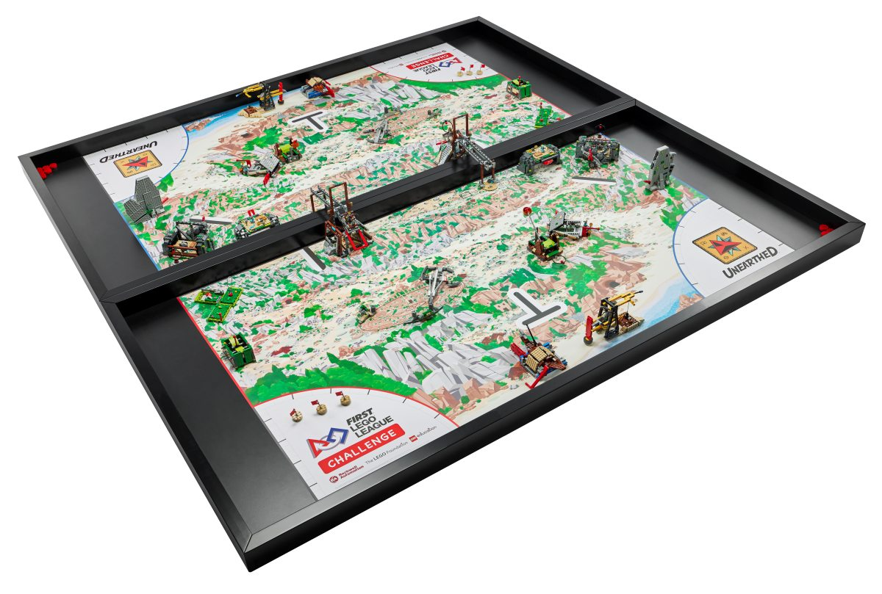
This year’s Theme: UNEARTHEDSM
During this archaeology-inspired season, teams use STEM and collaboration skills to unearth new findings about themselves and their collective communities to help build a better world.
Archaeologists use the archaeological process to reconstruct and understand the artifacts they have unearthed. Whether they are excavating a site or studying materials in a laboratory, it takes people working together with technology to find the clues needed to understand how past generations lived, learned, and celebrated.
In the UNEARTHED™ season, each team’s challenge is to identify a problem faced by archaeologists and propose a solution that can help.

Slide 5
Project Sparks
The Engineering Notebook contains “project sparks” – scenarios and questions to get teams thinking about possible project ideas. These include:
How archaeologists identify possible locations for artifacts
How technology can be used to map archaeologic sites
What tools archaeologists use to excavate fragile artifacts
How restoration processes can be improved
How archaeologists can work with professionals in other careers
The Engineering Notebook also includes a “careers and technology” page. The list includes archaeologists, site managers, lab technicians, conservators, anthropologists and geologists. This page can also inspire engaging and innovative project ideas!

Slide 6
What’s new this year?
Last season saw major changes to judging, including the new Peer Award, the introduction of the Final Share & Feedback interview component, and updates to rubrics.
There are no major changes to awards or processes for this season. However, judging documents have been updated for this season.
Also, there is a “Judge Guide and Quiz” available from firstinspires.org, but note that this is intended for judges at US/Canada events.

Slide 7
Equity, Diversity and Inclusion
FIRST is committed to fostering, cultivating and preserving a culture of equity, diversity, and inclusion. We embrace and encourage differences in race, ethnicity, national origin, sex, gender, gender identity, gender expression, sexual orientation, disability, age, religion, income, language, learning difference, or any other characteristics that make our adult-force and students unique.
You can help by:
Viewing relevant EDI training materials
Checking with your Judge Advisor about teams with students who require special considerations
Providing appropriate accommodations during interviews, such as allowing students to sit down or wear dark glasses
Keeping the FIRST Core Values in mind at all times!

Slide 8


Slide 9
What is FIRST LEGO LEAGUE Challenge?
FIRST LEGO League introduces STEM to children ages 4-16 through fun, exciting hands-on learning. Participants gain real-world problem-solving experience through a guided, global robotics program, helping today’s students and teachers build a better future together.
Using STEM concepts, students overcome the same challenges that face scientists today. They develop critical-thinking and presentation skills, build habits of learning and self-confidence in STEM, and have a ton of fun while working as part of a team.
FIRST LEGO League Challenge involves four components:
Robot Game
The Robot Design
The Innovation Project
The FIRST Core Values

Slide 10
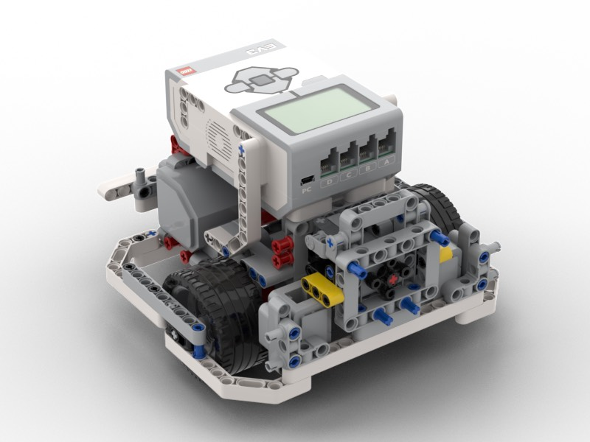
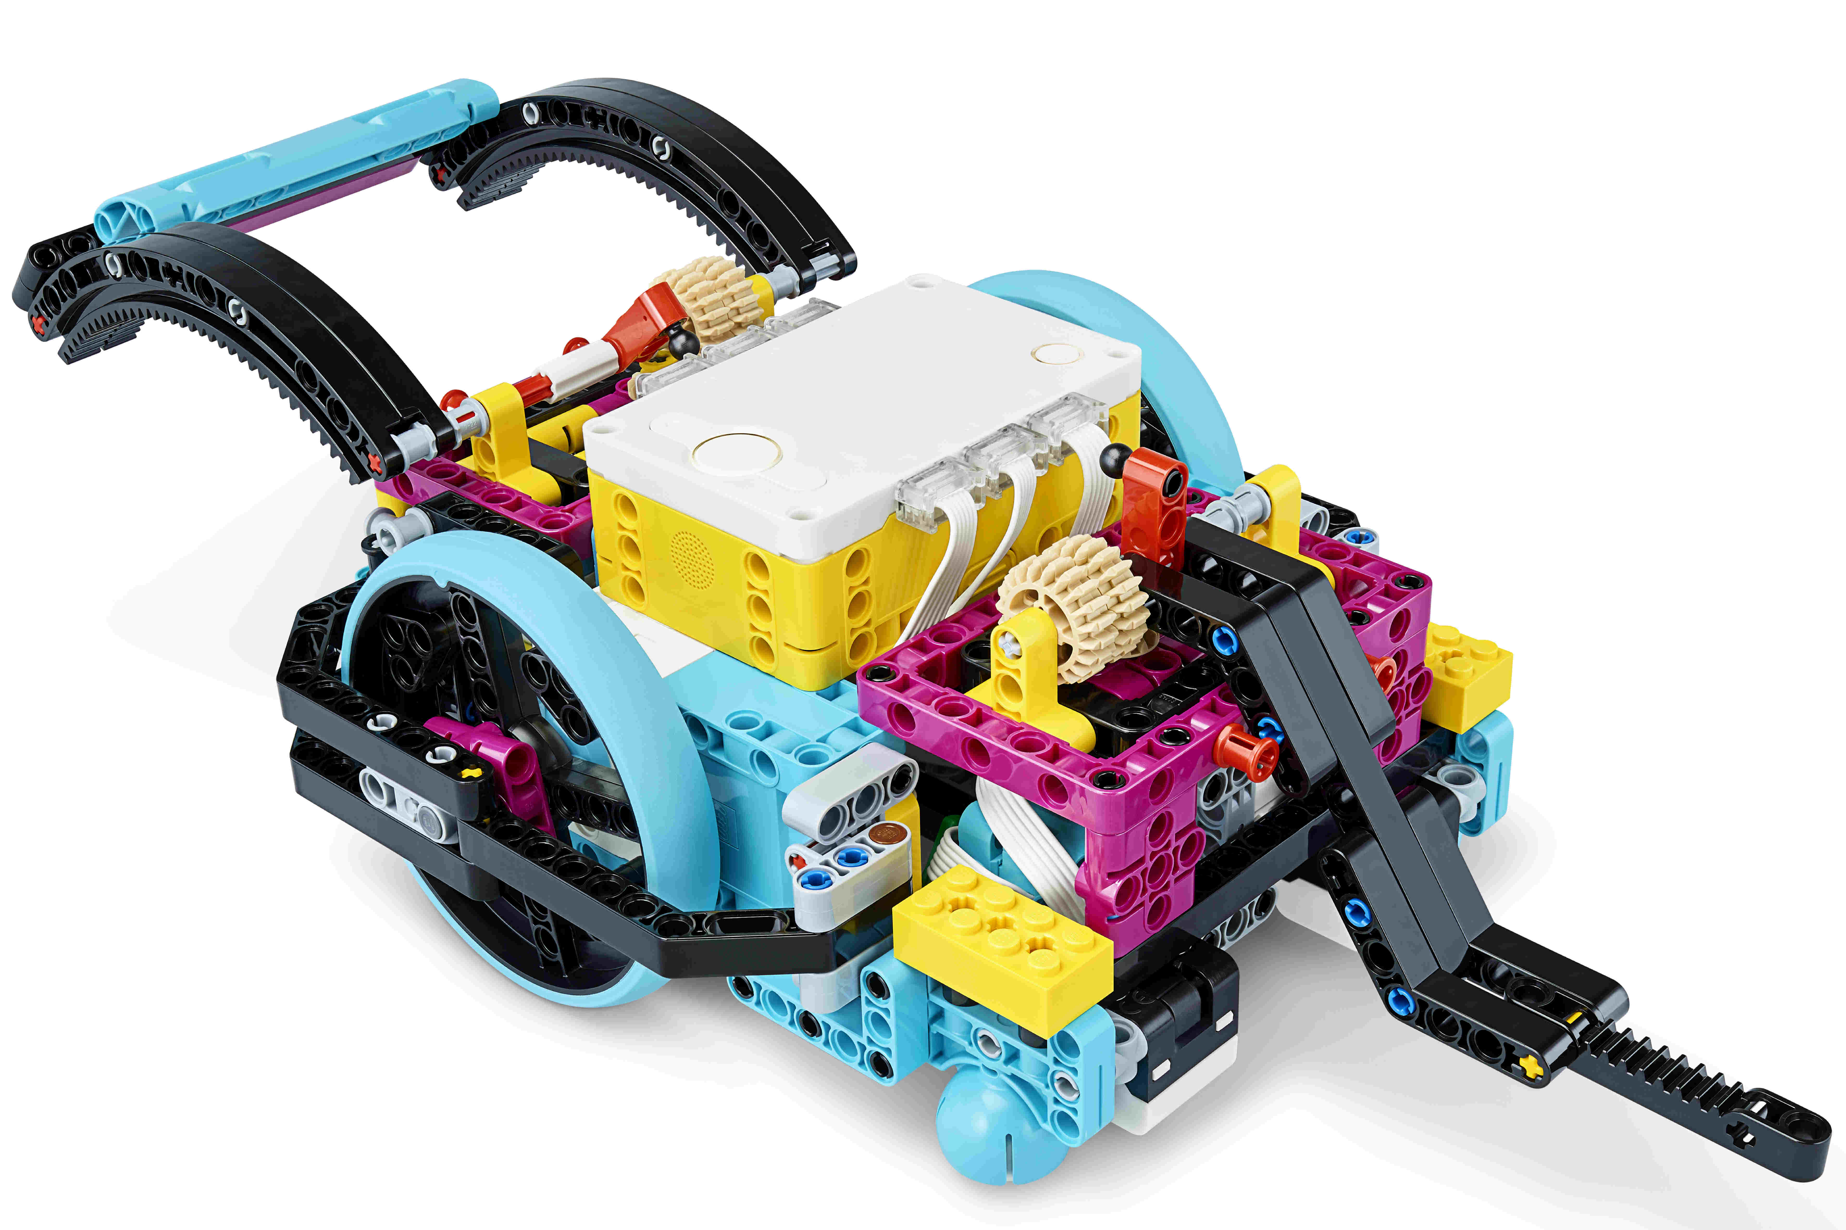
The robots!

Slide 11
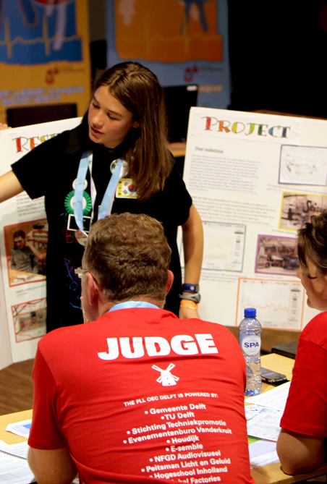
The judging role
The primary role of a judge is to interview and observe teams together with other judges in the same judging group, also known as the judging pod, using the FIRST LEGO League Challenge event rubrics.
You serve as a mentor and role model for the team members, motivating them with useful feedback.
After interviewing the teams, you will participate in the deliberation process to determine the award winners will write short awards scripts extolling merits of winning teams.
Judges are guests at the closing ceremony and take part in recognizing and presenting awards to the teams.

Slide 12
A typical day as a judge
Morning Activities:
Afternoon Activities:
Register with the volunteer coordinator.
Meet the judges, collect your clipboard and find the judging rooms.
Attend the Opening Ceremony.
Scheduled interviews with teams.
Lunch?
Award deliberations.
Script writing.
Attend the Closing Ceremony.

Slide 13
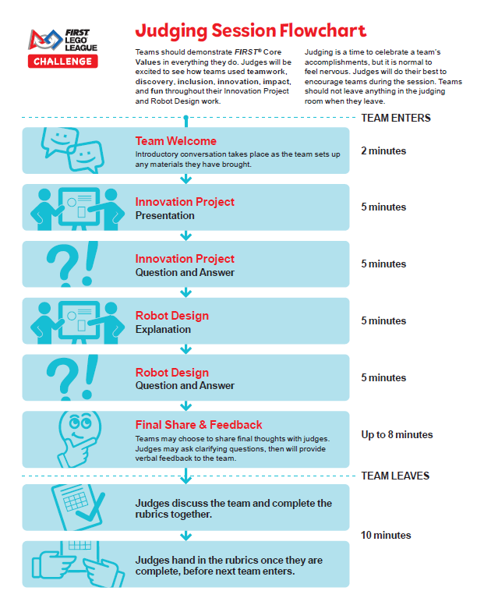
Judging session flowchart
Key points:
30-minute interview (plus 15 minutes for judge deliberations)
5 minutes uninterrupted presentation time for Innovation Project and Robot Design
An opportunity for teams to share their final thoughts with the judges
Immediate feedback to teams

Slide 14
Important notes
Teams should be prepared with their Innovation Project props, robot and code
All students must attend the judging session
The judging session is the team’s time to shine – coaches cannot contribute, prompt or otherwise interfere
Teams cannot leave judging materials behind
Coaches can observe the session but the number can be limited to two adults
Some teams may have students that require special accommodations
Judges are not to be photographed or filmed
Stay on time and complete the rubrics as you go!
What happens in the judging room, stays in the judging room

Slide 15
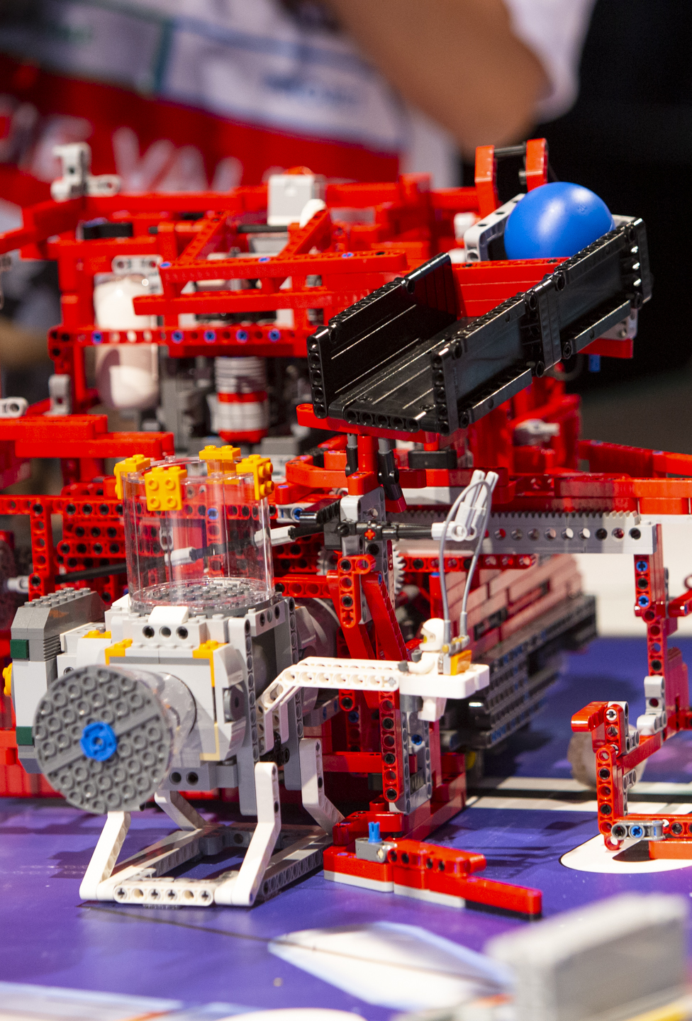
Judging Documents
Judging Session Flowchart
Judging Session Script – AUS Version
Rubrics
Awards
Team List
Judging Schedule

Slide 16
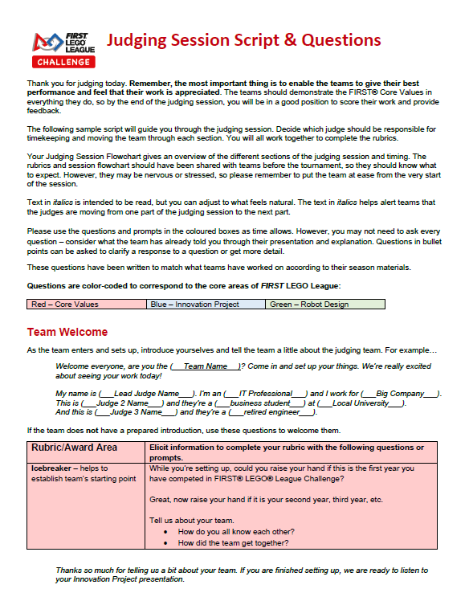
Judging session script
The script is your guide through the interview.
Italicised text assists in transitioning between elements of the interview.
Questions in coloured boxes related to specific rubric criteria.
Yes, judges may deviate from the script! But the Innovation Project, Robot Design and Final Share and Feedback elements must happen in the correct order.

Slide 17
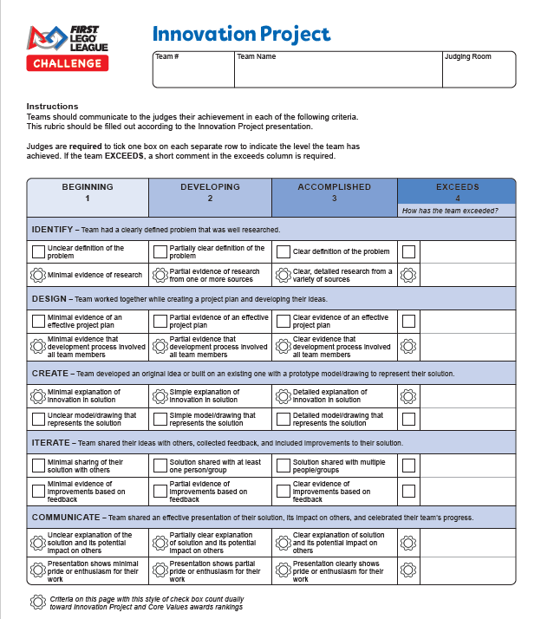
rubrics
Key points:
One page for Innovation Project and one for Robot Design, plus a full page for written feedback
Complete one copy per team (not per judge)
You must select one number per criteria – the spreadsheet won’t allow 1.5 or 2.5
Remember to check the optional awards
Teams get these back – so keep comments constructive!

Slide 18
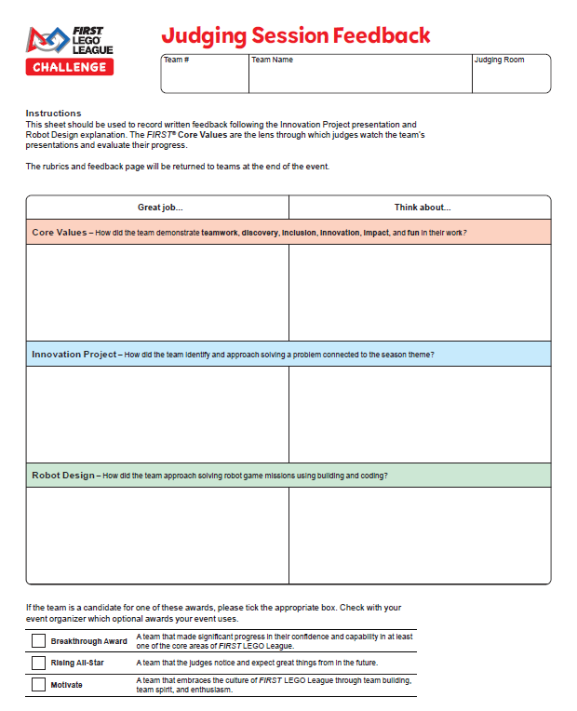
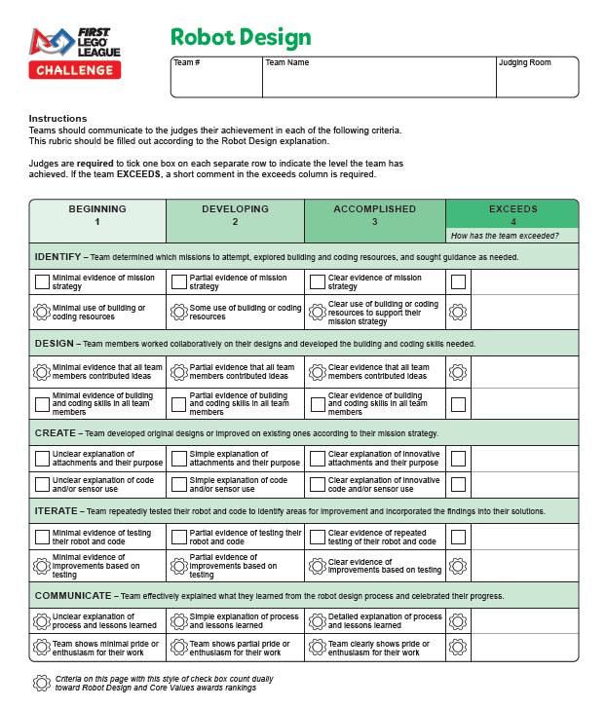

Slide 19
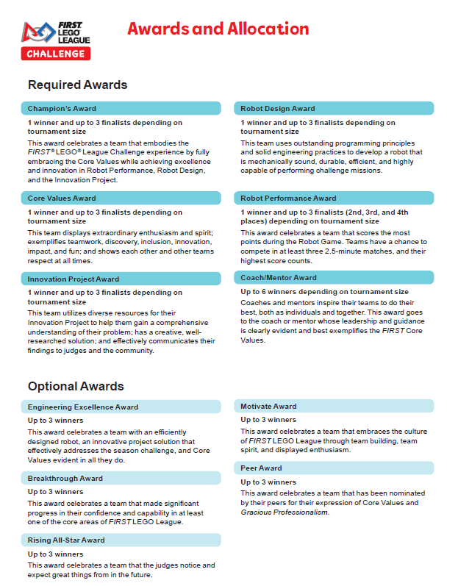
awards
Key points:
All events give out the Required Awards, but smaller events may not receive all the Optional Awards.
The Robot Performance Award is decided by the referees, not the judges!
The Coach/Mentor Award and Peer Award are nomination-based.

Slide 20
Providing feedback to teams
Judges provide verbal feedback to teams during the 30-minute judging session and written feedback on the rubrics. Feedback should be positive and encouraging while helping the team identify how they can improve.
“We love the energy you bring to the judging room!”
“What I really liked about your Innovation Project was how…”
“For your next competition, what I would love to see is…”
Again, the role of the judges is to encourage and inspire the teams!

Slide 21
What are we looking for – Robot Design
In mechanical design, look out for:
Modified or innovative drive bases
Attachments or systems that complete multiple missions at a time
Use of additional motors
Rack and pinion systems, one-way latches, pneumatics, etc.
Research and problem-solving!
In terms of process, look out for:
Mission selection process
Path planning (is there a map?)
Multiple missions grouped into one run
How the work was split up between members
How testing and iteration was done
Documentation
In programming, look out for:
Generally…
Commenting/readability of code
MATHS!
Sensors…
Colour: line following or line squaring, proportional or PID control
Touch: finding obstacles or squaring up
Gyro: drive straight, turn to heading
Ultrasonic: innovative uses
Do they understand what they have done?

Slide 22
What are we looking for – innovation project
How ideas were brainstormed + how the final concept was selected
Depth of research and quality of resources
Has the solution been modelled/prototyped/made?
Has the solution been shared and with who?
Were experts consulted and how did the team respond to feedback?
Was the community consulted and how did the team respond to feedback?
Presentation style: fun and engaging?
Did they provide other documentation?
Is the solution genuinely innovative?
Is the solution actually viable?

Slide 23
What are we looking for – core values
How did they make decisions?
How did they deal with conflicts?
Any strong examples of diversity and inclusion?
How do they make all team members feel like part of the team?
Do they help other FLL teams?
Do they volunteer in their community?
Did they have FUN?
Can they define Gracious Professionalism?

Slide 24
What happens after the interviews?
Once all interviews are complete:
Complete all rubrics and submit them to the judge advisor.
Convene in the judge’s meeting room for deliberations.
We will review the match score and judging data before deciding on our award recipients.
The deliberations process is guided by the Judge Advisor and all judges are involved. Awards must be allocated in a specific order.
Finally, we will write the award scripts!

Slide 25
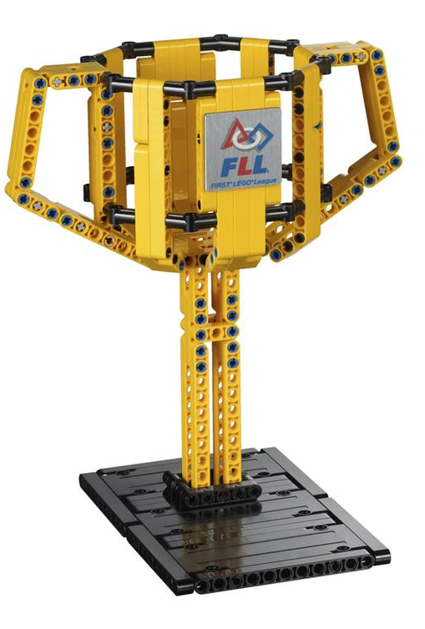
Award eligibility
To be eligible for any award, teams must:
Have between 2 and 10 members
Be aged 9-16 years at the start of the year the challenge is released
Participate in all four aspects: Robot Game, Innovation Project, Robot Design and Core Values
Demonstrate the Core Values and behave with Gracious Professionalism at all times

Slide 26
Award Scripts
After the awards have been decided, the judges can write the award scripts. These should:
Describe why the team was chosen to receive the award
Give clues about the winner but only reveal their identity in the last lines
Be funny – use puns and jokes!
Follow an AABB rhyme scheme (use rhymezone.com)
At most qualifying events, award scripts should be:
4 lines for the Champion’s Award and 2 lines for the rest

Slide 27
Example Scripts
2nd Place Champion’s Award
Core Values Award
This team's tech log goes all season long
Shooting for the moon their GP is strong
Removing barriers for equal play they lead, don't follow
The judges are very pleased to congratulate Team Apollo
A truly inspirational team
That had a colourful hat theme
With the use of just three simple keys
They solved all of their problems with ease

Slide 28
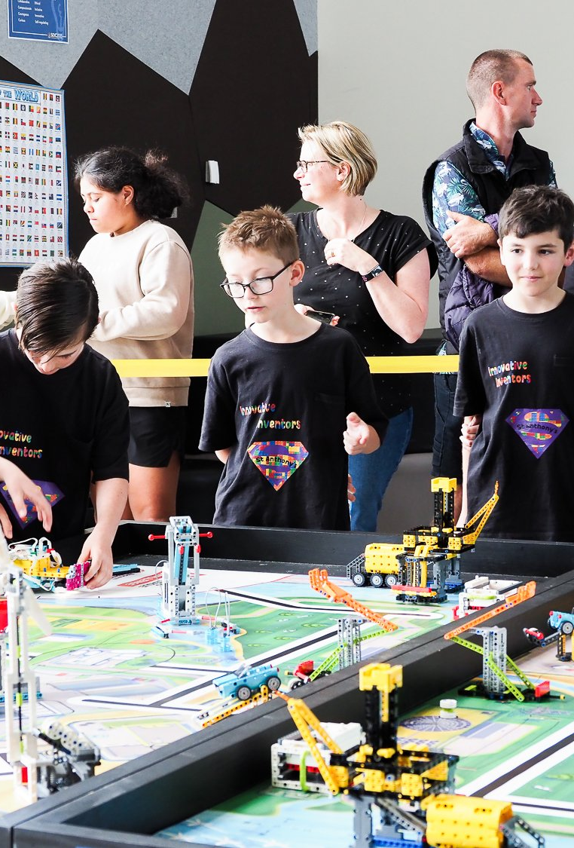
Next steps?
Read the documentation in advance – this will help you feel more confident on the day! Also, considering watching the Robot Game Missions video, available from the FIRST LEGO League Challenge YouTube channel.
For questions about the judging process, contact your Judge Advisor.
For questions about the event, contact your Tournament Director.
Have fun and robot on! 3-2-1 LEGO!!!

